Slide 1
California Renewable Energy:
A Preliminary Exploratory Analysis
By Abraham Huitron

Slide 2
The Data
California Independent Systems Operator (CAISO)
An organization built to maintain the reliability of one of the largest, most modern power grid in the world. They operate a transparent and accessible wholesale energy market, working diligently to meet the electricity needs of its consumers, while at the same time, increasing the amount of renewable energy for the future. (California ISO - Our business, 2022)
Kaggle Dataset Subset
Renewable energy sources
Hourly power generated values in megawatts (MW)
Date Range: 2010 – 2018
Notes:
Kaggle Dataset Subset
Some data missing such as Solar, Solar Photovoltaic, Solar Thermal
Good discussion point.
Question…why just 2010-2018?
Time
Ease of access

Slide 3
Energy Types
Fuel | Description
BIOGAS | Biogas a mixture of gases, consisting of methane, carbon dioxide and hydrogen sulphide, produced from raw materials such as agricultural waste, manure, sewage, and others. (Biogas - Wikipedia, 2022)
BIOMASS | Biomass is a clean, renewable energy source, initiated from the sun, plants, and algae. Trees, crops, and other food waste also contribute to this energy source. (2022)
GEOTHERMAL* | Originated from the Greek words geo (earth) and therme (heat), geothermal energy is a form of heat energy that is sourced from inside our planet earth. It is used to heat baths, buildings, and much more. (Geothermal explained - U.S. Energy Information Administration (EIA), 2022)
SMALL HYDRO* | Hydroelectric power is the generation of electric power from the movement of water. Small hydro is a power station designed for a small community or industry, typically generating small amounts of power than traditional full hydro systems. (Small hydro - Wikipedia, 2022)
SOLAR | Solar power is energy from the sun that is converted into thermal or electrical energy. It is the cleanest, most abundant, renewable source available. The U.S. is known for having some of the richest solar resources in the world. (About Solar Energy | SEIA, 2022)
SOLAR PV* | Photovoltaics (often shortened as PV) gets its name from the process of converting light (photons) to electricity (voltage), which is called the photovoltaic effect. Today, electricity from solar cells has become the most cost competitive in many regions. (Solar Photovoltaic Technology Basics, 2022)
SOLAR THERMAL | Solar thermal generator systems collect and concentrate sunlight to produce the high temperature heat needed to generate electricity. This method uses reflectors and storage systems to gather and aggregate the sun’s heat energy. (Solar thermal energy - Wikipedia, 2022)
WIND TOTAL* | Wind is used to produce electricity using the kinetic energy created by air in motion. This is transformed into electrical energy using wind turbines or wind energy conversion systems. (Wind, 2022)
Notes:
Asterisk for the ones covering in the presentation due to time

Slide 4
Data Detail
Variable Name | Description
TIMESTAMP | The date/time of the record. (YYYY-MM-DD hh:mm:ss)
BIOGAS | The amount of power generated by biogas. (MW)
BIOMASS | The amount of power generated by biomass. (MW)
GEOTHERMAL* | The amount of power generated by geothermal. (MW)
Hour | The hour of the day. (24 HR)
SMALL HYDRO* | The amount of power generated by small hydro. (MW)
SOLAR | The amount of power generated by solar. (MW)
SOLAR PV* | The amount of power generated by solar photovoltaic. (MW)
SOLAR THERMAL | The amount of power generated by solar thermal. (MW)
WIND TOTAL* | The amount of power generated by wind. (MW)

Slide 5
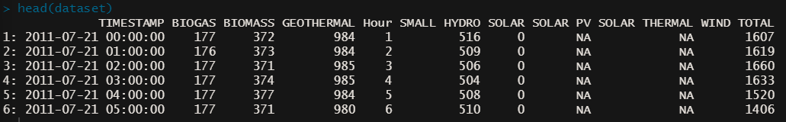
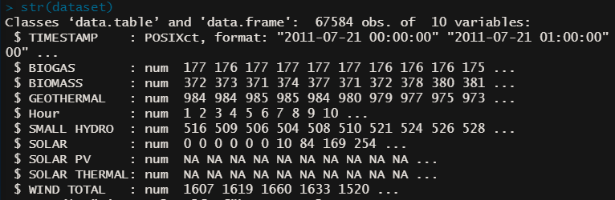
Data Preview
Columns | Rows
10 | 67,584

Slide 6
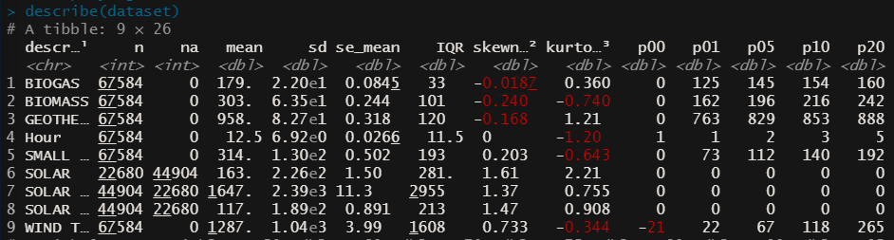
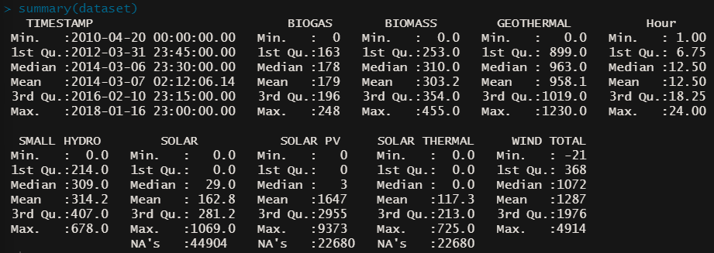
Data Preview Cont. (Statistics)
Notes:
Describe
Standard Deviation: Lower value = less spread, higher value = more spread
Standard Deviation of the Mean
IQR: Measuring the spread of data points across the mean; 75th – 25th
Skewness: >1 or <-1 indicates a highly distribution. A value between -0.5 and 0.5 indicates that the distribution is fairly symmetrical.
Kurtosis: A measure of whether the data are heavy-tailed or light-tailed relative to a normal distribution.

Slide 7
Questions?

Slide 8
Questions?
What can this data tell us about the production of renewable energy over the given period?
Is there seasonality? Is it daily? Monthly? Yearly?
Which methods of energy generation are used most?
Different methods generate at different speeds.
Which methods appear to be growing vs. declining? Why?
More adoption? Cheaper operating costs?
Can we predict/forecast the values of future time periods?
Why would we want to know this value?

Slide 9
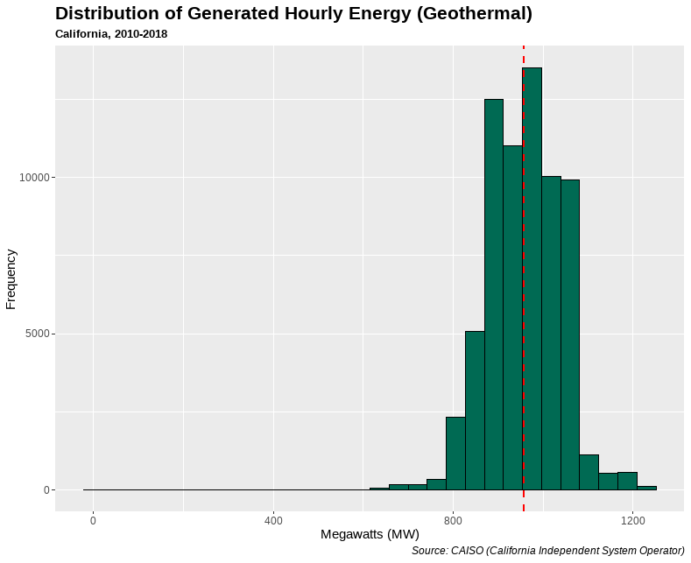
Source #1 – Geothermal (Distribution)
Name | Value
Rows | 67,584
Min | 0 MW
Max | 1,230 MW
Average | 958.1 MW

Slide 10
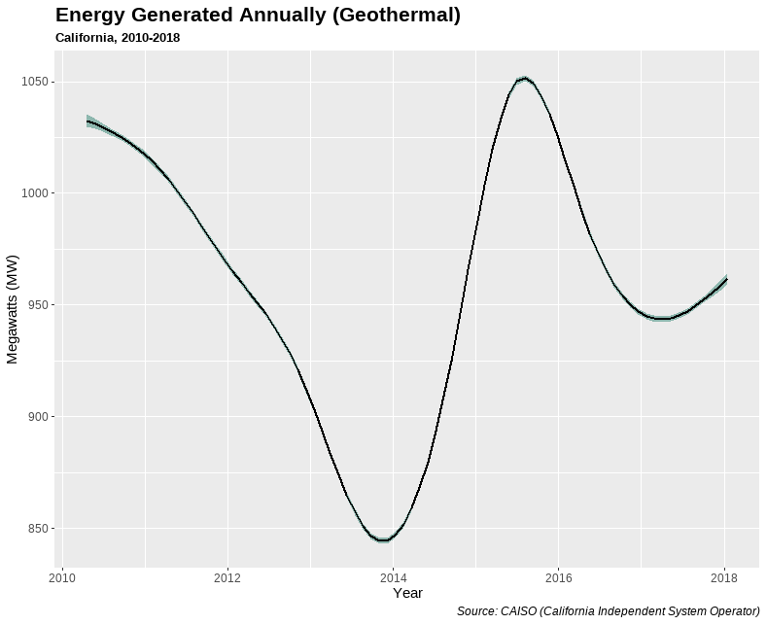
Source #1 – Geothermal (Time Series)
Name | Value
Rows | 67,584
Min | 0 MW
Max | 1,230 MW
Average | 958.1 MW

Slide 11
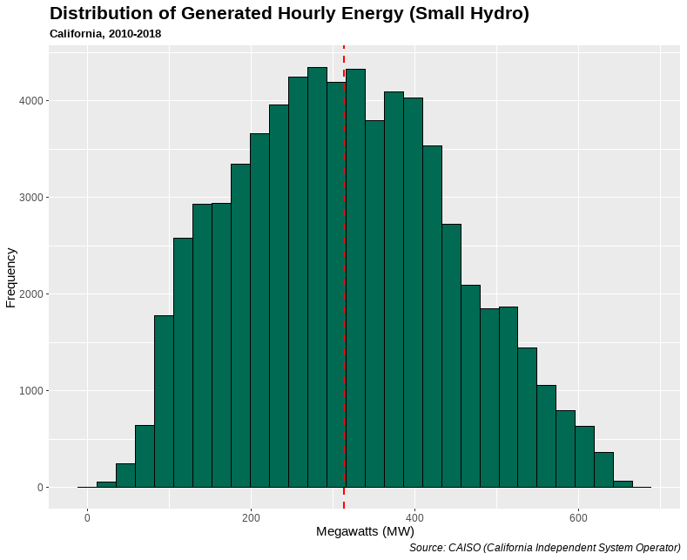
Source #2 – Small Hydro (Distribution)
Name | Value
Rows | 67,584
Min | 0 MW
Max | 314.2 MW
Average | 678 MW

Slide 12
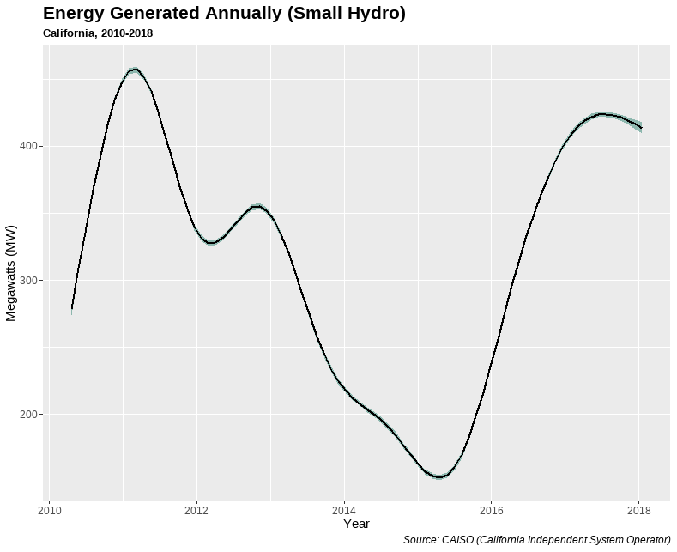
Source #3 – Small Hydro (Time Series)
Name | Value
Rows | 67,584
Min | 0 MW
Max | 314.2 MW
Average | 678 MW

Slide 13
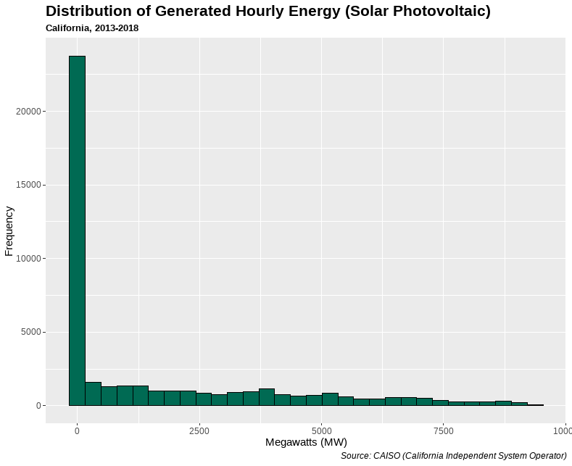
Source #3 – Solar Photovoltaic (Distribution)
Name | Value
Rows | 44,904
Min | 0 MW
Max | 1,647 MW
Average | 9,373 MW

Slide 14
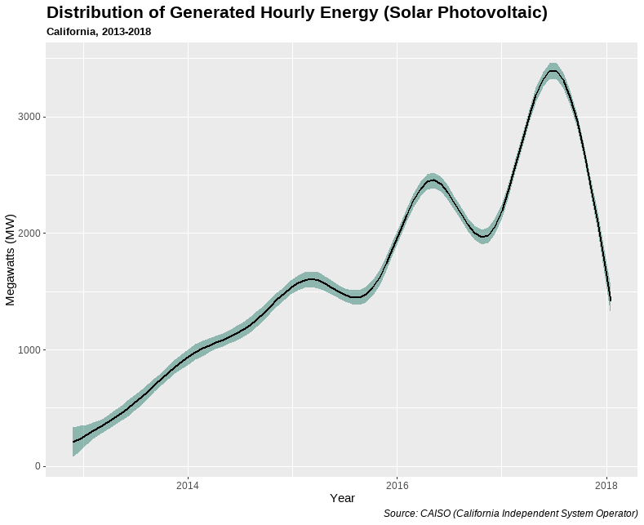
Source #3 – Solar Photovoltaic (Time Series)
Name | Value
Rows | 44,904
Min | 0 MW
Max | 1,647 MW
Average | 9,373 MW

Slide 15
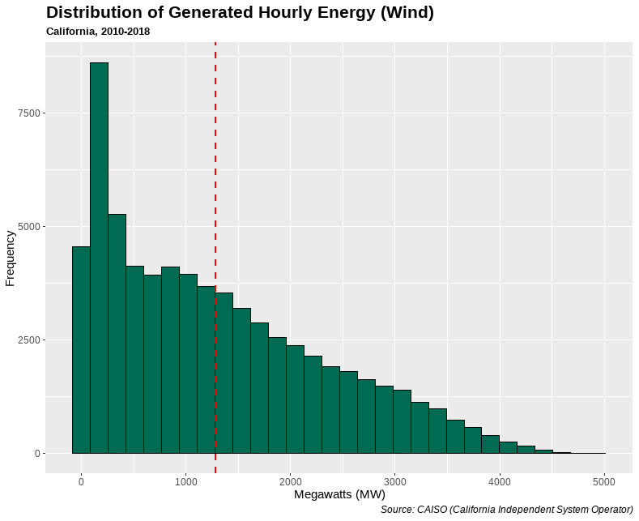
Source #4 – Wind (Distribution)
Name | Value
Rows | 67,584
Min | -21 MW
Max | 1,287 MW
Average | 4,914 MW

Slide 16
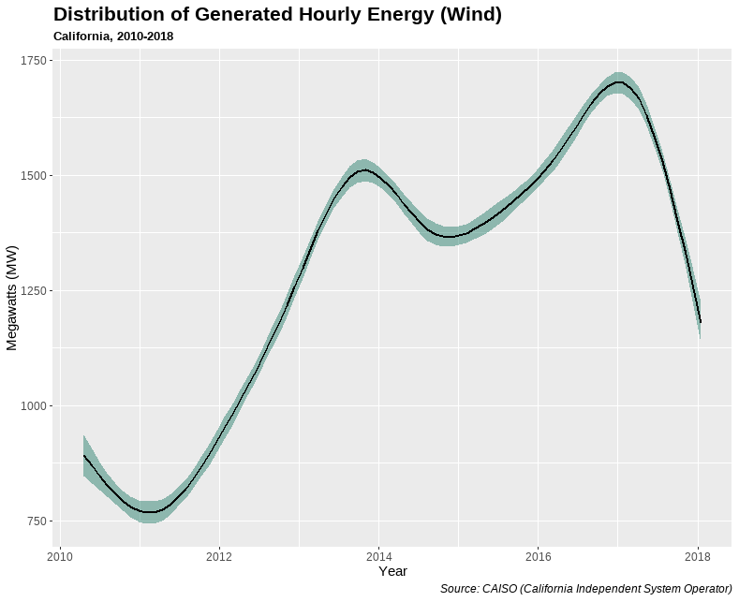
Source #4 – Wind (Time Series)
Name | Value
Rows | 67,584
Min | -21 MW
Max | 1,287 MW
Average | 4,914 MW

Slide 17
Power BI – Full Interactive Report

Slide 18
Follow Up/Research Questions
Can we utilize the seasonality of the production methods in order to maximize energy production efficiently?
With further research, could we analyze which technologies are better to pursue in the future?
Is it cheaper to produce one form of energy over another? Is it also easier?
Can we further predict the growth of adoption/popularity of current or newer technology?
Is one technology limited in its daily production than others?
Can we get more data to analyze more forms even deeper?
How can we handle missing values?
Investigate missing values
Notes:
What can this data tell us about the production of renewable energy over the given period?
Is there seasonality? Is it daily? Monthly? Yearly?
Which methods of energy generation are used most?
Different methods generate at different speeds.
Which methods appear to be growing vs. declining? Why?
More adoption? Cheaper operating costs?
Can we predict/forecast the values of future time periods?
Why would we want to know this value?

Slide 19
Thank You
Notes:
What can this data tell us about the production of renewable energy over the given period?
Is there seasonality? Is it daily? Monthly? Yearly?
Which methods of energy generation are used most?
Different methods generate at different speeds.
Which methods appear to be growing vs. declining? Why?
More adoption? Cheaper operating costs?
Can we predict/forecast the values of future time periods?
Why would we want to know this value?

Slide 20
Sources
Caiso.com. 2022. California ISO - Our business. [online] Available at: <http://www.caiso.com/about/Pages/OurBusiness/Default.aspx> [Accessed 1 August 2022].
Eia.gov. 2022. Geothermal explained - U.S. Energy Information Administration (EIA). [online] Available at: <https://www.eia.gov/energyexplained/geothermal/#:~:text=Geothermal%20energy%20is%20heat%20within,buildings%2C%20and%20to%20generate%20electricity.> [Accessed 29 July 2022].
En.wikipedia.org. 2022. Biogas - Wikipedia. [online] Available at: <https://en.wikipedia.org/wiki/Biogas#:~:text=Biogas%20is%20a%20mixture%20of,is%20a%20renewable%20energy%20source.> [Accessed 29 July 2022].
En.wikipedia.org. 2022. Small hydro - Wikipedia. [online] Available at: <https://en.wikipedia.org/wiki/Small_hydro> [Accessed 29 July 2022]
En.wikipedia.org. 2022. Solar thermal energy - Wikipedia. [online] Available at: <https://en.wikipedia.org/wiki/Solar_thermal_energy> [Accessed 29 July 2022].
Irena.org. 2022. Wind. [online] Available at: <https://www.irena.org/wind#:~:text=Wind%20is%20used%20to%20produce,the%20turbine%20connected%20to%20them.> [Accessed 29 July 2022].
Nationalgeographic.org. 2022. [online] Available at: <https://www.nationalgeographic.org/encyclopedia/biomass-energy/#:~:text=Biomass%20is%20a%20clean%2C%20renewable,and%20can%20be%20managed%20sustainably.> [Accessed 29 July 2022].

Slide 21
Sources Cont.
Nrel.gov. 2022. Solar Photovoltaic Technology Basics. [online] Available at: <https://www.nrel.gov/research/re-photovoltaics.html> [Accessed 29 July 2022].
SEIA. 2022. About Solar Energy | SEIA. [online] Available at: <https://www.seia.org/initiatives/about-solar-energy> [Accessed 29 July 2022].

